Slide 1
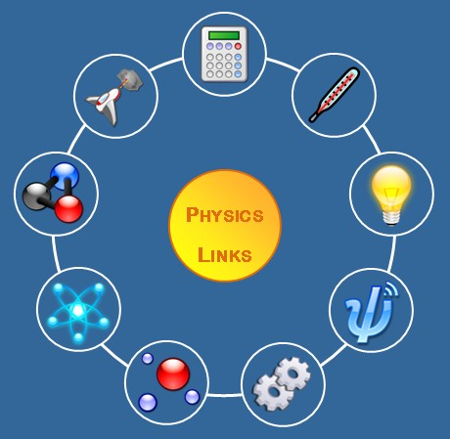
Introduction
NASC 3
Physics in Everyday Life
PHYSICS
http://www.physics.ox.ac.uk/pjcc/LINKS/new/normal.jpg

Slide 2
Have you tried these?

Slide 3
Have you tried these?

Slide 4
Have you tried these?

Slide 5
Have you tried these?

Slide 6
Have you tried these?

Slide 7
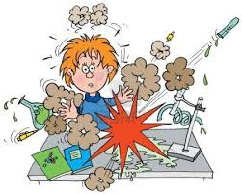
Science
Systematic body of knowledge
Other forms of knowledge (with low degree of organization):
Gossips/rumors
News reports
Everyday experiences
www.123rf.com

Slide 8
Laws
concise but general statements how nature behaves.
Theories
Detailed explanation of why something happens.

Slide 9
Physics
PHYSICS
“knowledge of nature”
derived from “physika” meaning “natural things”

Slide 10
What is Physics ?
Science that deals with matter and energy
Aim:
Matter and Energy
Describe
(empirical equations, models, etc. )
Understand
(laws and theories)

Slide 11
Why study Physics?
Physics, the most fundamental science, is concerned with the basic principles of the Universe.
It is the foundation upon which the other sciences - astronomy, biology, chemistry and geology – are based.

Slide 12
Classical Physics (< 20th century)
Mechanics – deals with motion, inertia, force at energy.
Thermodynamics – involves heat flow, heat transformations at temperature measurements
Electricity and Magnetism – deals with aspects of matter at space, emphasis on electric charge and electric current
Optics – nature and propagation of light

Slide 13
Modern Physics (≥20th century)
Modern Physics – extension of physics at the atomic and macroscopic level.
Relativity
Quantum Mechanics
Condensed-matter physics
Nuclear physics
Astrophysics

